Slide 1
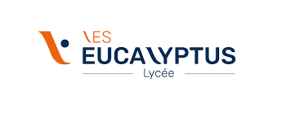
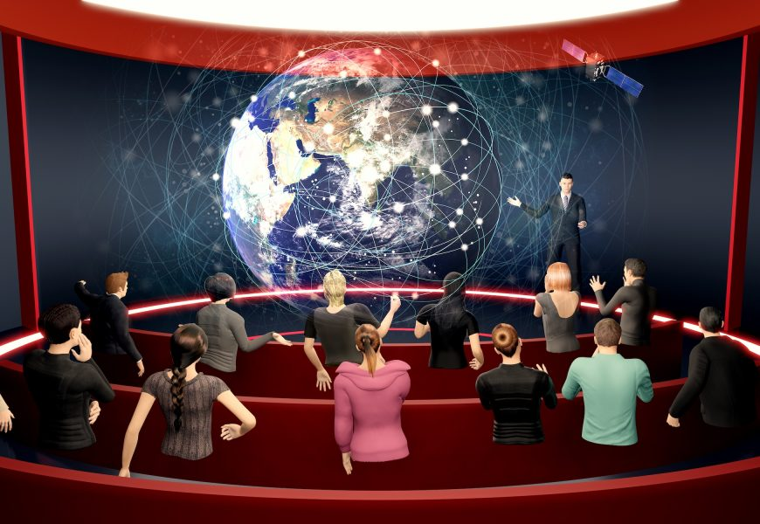
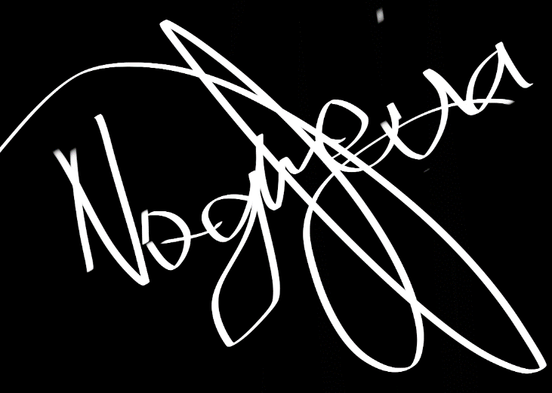
Economic issues
The prospects for development are exponential, the investment race has begun.
The turnover of the metaverse will approach 800 billion dollars in 2024
However, the relevance of these investments cannot be judged (speculation)
The metaverse is a real and concrete project
Brands already investing in this technology
Apple
Microsoft bets on Mesh
Nikeland & RTFKT, Nike’s virtual properties
Adidas
Carrefour buys land in Sandbox
Metaverse: a concept born in 1992
The first time the term appeared was in the book The Virtual Samurai, published in 1992 by the American Neal Stephenson. In this book, the author depicts a rich entrepreneur – a Mark Zuckerberg before his time? – which has created a parallel world, where virtual reality and augmented reality come together. And where the ultimate goal is to control the minds of users.
What are the dangers of Metaverse?
Sexual and moral harassment at the Metaverse.
The psychological danger of double living in the Meta.
The processing of personal data.
the problem of the environment (emissions of greenhouse gases (currently 4% of emissions are due to digital technology))
body alienation/escape
Why was it created and its access
A complete social virtual experience. ex: Facebook meta platform in 2021
be entertained/create connections/facilitate exchanges in a totally virtual way
It is accessed through the internet
The indispensable kit for an optimal virtual experience
VR headsets
Smart glasses
internet access
Project Upland
The Qatar project set up by Upland in its virtual world is quite different from the projects that were previously launched on the platform. Indeed, unlike the previous cities of Upland, which from their opening were accessible to the public, the properties of Qatar are exclusive. They will serve as rewards for players who participate in various activities and challenges during the tournament.
t’s pretty clear that the project leaders want to make Metaverse Qatar 2022 a fun experience that allows fans to relax and support their teams.
According to the latest reports, Upland also plans to take advantage of the growing interest in digital collectibles to promote its own football-themed NFT and specifically on Qatar 2022. Each Upland player will be able to collect and exchange highlights and digital moments in the form of NFT.
In addition, players will also have the opportunity to purchase virtual fields, build entire neighbourhoods and create businesses or attractions to generate revenue.

